Slide 1
Guest Lecture Stanford ME469: Common low-Mach Discretization Approaches
Stefan P. Domino
Computational Thermal and Fluid Mechanics
Sandia National Laboratories SAND2018-4536 PE

Slide 2
Common low-Mach Discretization Approaches: Outline
Why Unstructured?
Unstructured Element Typoes
Model PDE for Discretization
Finite Element Method (FEM)
Control-Volume Finite Element Method (CVFEM)
Edge-based Vertex-Centered (EBVC)
Cell-centered Finite Volume (FV)
Staggered arrangement
Conclusions

Slide 3
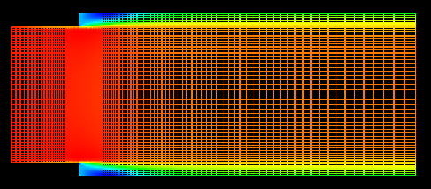
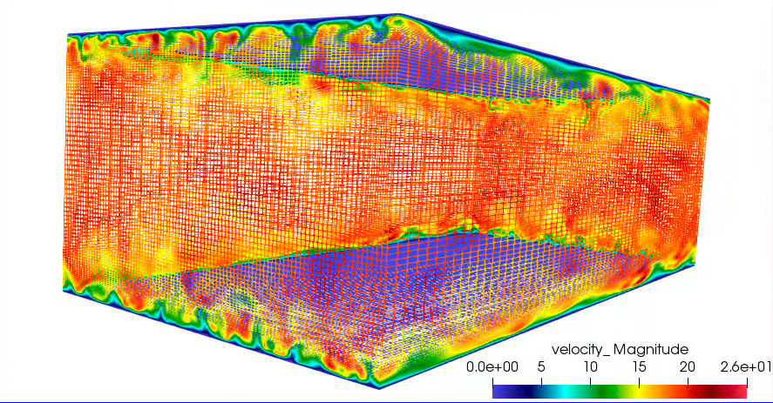
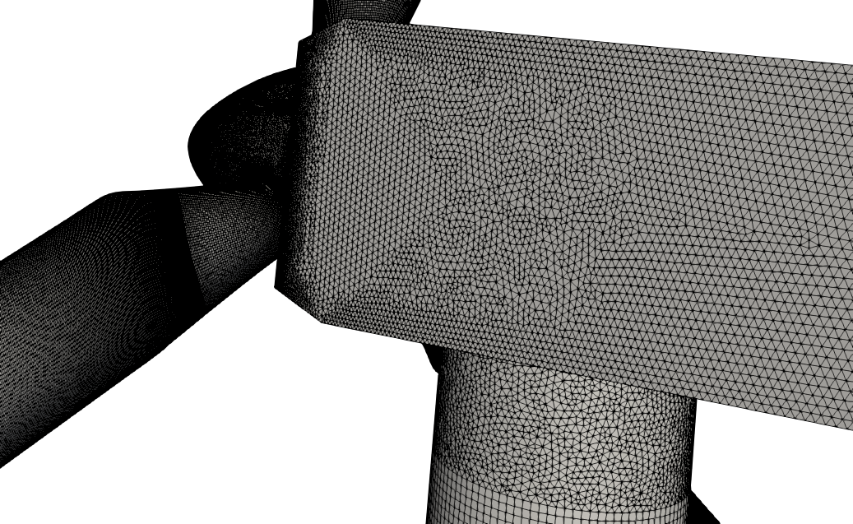
Structured vs Unstructured
Many times, the canonical flows of interest are in simplified geometries that allow for cartesian meshes – with “stair-stepping”
RANS-based backward facing step (Domino, 2012)
Re^{τ} 395 plane-channel (Jofre, Domino, Iaccarino, 2018)
Often times, not!
https://www.itascainternational.com/software/introduction-to-meshing

Slide 4
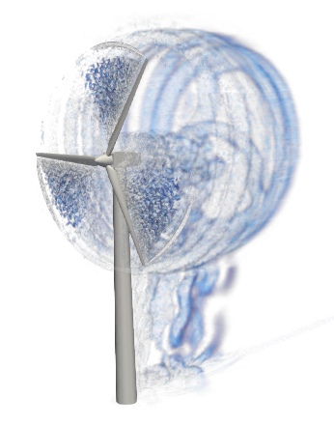
Reality: Meshing time for complex applications remains a significant bottleneck!
Many applications of interest to SNL contain complex geometries
low-Mach fluids users interested in high-quality simulation results tend towards hexahedral-based topologies (if possible)
However, if a scheme is “design-order” accurate, any topology may suffice as it is simply a matter of mesh size and efficiency – not unlike the active discussion on low- vs higher-order
Sometimes, the penetration of a low-Mach fluids physics addition in common analysis is high as the meshing can be prohibitively complex
UUR Example: Vestas V27 225 kw hybrid low-order hex/tet/pyr/wedge
Very complex world – stair-stepped!

Slide 5
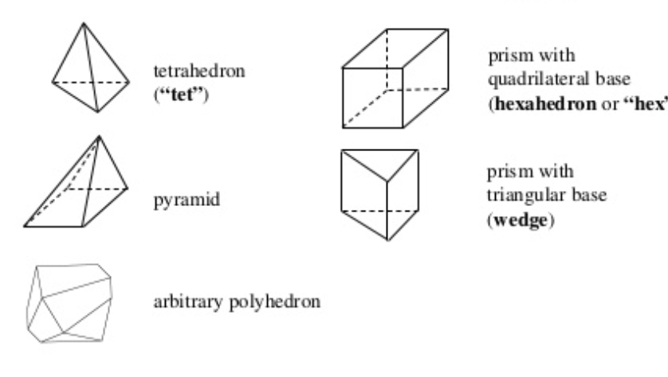
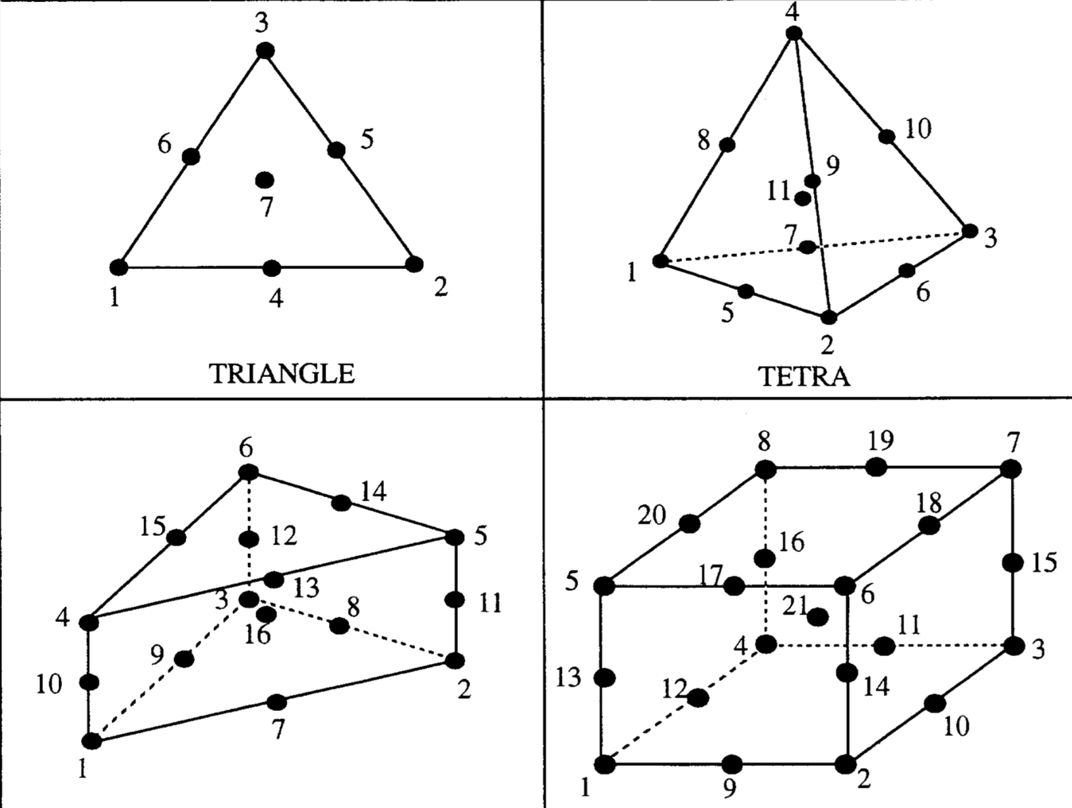
Examples of Various Topologies
Hex8
Tet4
Pyramid5
Wedge6
Arbitrary
Higher-order promoted elements (Hex27, Tet10, Wedge16, Hex64, etc.)

Slide 6
In Fairness…. The Carbon-Capture Multidisciplinary Simulation Center
15MW coal-fired boiler volume rendered image of large (90 μm) particles
Staggered schemes have been demonstrated to support complex applications
Cut-cells and embedded approaches help
http://ccmsc.utah.edu/about.html

Slide 7
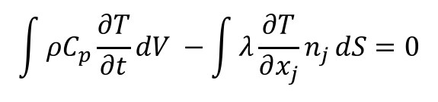
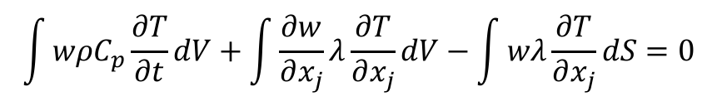
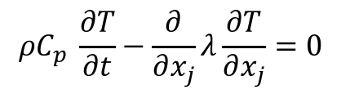
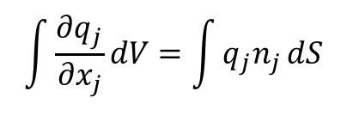
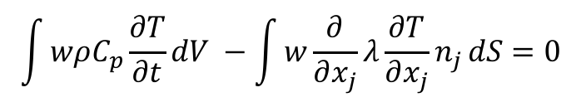
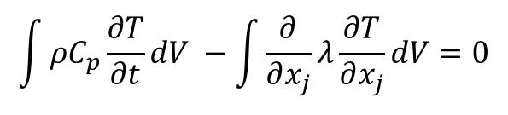
Fundamentals of Discretization
Given a partial differential equation (PDE) and associated volumetric form:
Applying Gauss Divergence provides the standard finite volume form:
We can also multiple PDE by an arbitrary test function, w, and integrate over a volume,
$$ρC_{p} \frac{∂T}{∂t}−\frac{∂}{∂x_{j}}λ\frac{∂T}{∂x_{j}}=0$$
$$\int{ρC_{p}\frac{∂T}{∂t}dV −\int{\frac{∂}{∂x_{j}}λ\frac{∂T}{∂x_{j}}}dV=0}$$
$$\int{\frac{∂q_{j}}{∂x_{j}}dV=\int{q_{j}n_{j}}dS}$$
$$\int{ρC_{p}\frac{∂T}{∂t}dV −\int{λ\frac{∂T}{∂x_{j}}n_{j}}dS=0}$$
$$\int{wρC_{p}\frac{∂T}{∂t}dV −\int{w\frac{∂}{∂x_{j}}λ\frac{∂T}{∂x_{j}}n_{j}}dS=0}$$
Next, integrate by parts and apply
Gauss-Divergence:
$$\int{wρC_{p}\frac{∂T}{∂t}dV+\int{\frac{∂w}{∂x_{j}}λ\frac{∂T}{∂x_{j}}}dV−\int{wλ\frac{∂T}{∂x_{j}}}dS=0}$$
Sometimes, you see T as T^{H} - the trial space

Slide 8
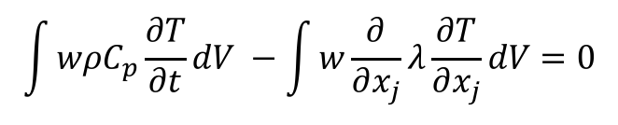
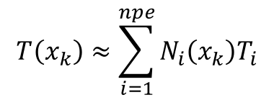
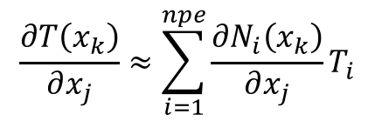
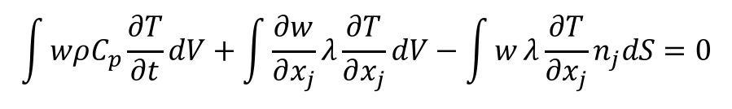
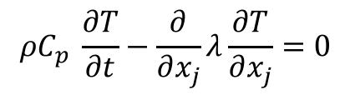
The Finite Element Method (FEM)
Consider an alternative approach in which a finite element method (FEM) is employed
Define an underlying nodal basis with the element:
Gaussian Quadrature is used
On a -1:1 range, +/- sqrt(3)/3
Consider a simple heat conduction model PDE,
Integrate using a test function,
Integration-by-parts (with G-D) provides:
Iterate element quadrature points
Note that N can be arbitrary in order (shown here for a linear)
$$T\left(x_{k}\right)≈\sum_{i=1}^{npe}{N_{i}\left(x_{k}\right)T_{i}}$$
$$\frac{∂T\left(x_{k}\right)}{∂x_{j}}≈\sum_{i=1}^{npe}{{\frac{∂N_{i}\left(x_{k}\right)}{∂x_{j}}T}_{i}}$$
$$ρC_{p} \frac{∂T}{∂t}−\frac{∂}{∂x_{j}}λ\frac{∂T}{∂x_{j}}=0$$
$$\int{wρC_{p}\frac{∂T}{∂t}dV −\int{w\frac{∂}{∂x_{j}}λ\frac{∂T}{∂x_{j}}}dV=0}$$
$$\int{wρC_{p}\frac{∂T}{∂t}dV+\int{\frac{∂w}{∂x_{j}}λ\frac{∂T}{∂x_{j}}}dV−\int{w}λ\frac{∂T}{∂x_{j}}n_{j}dS=0}$$

Slide 9
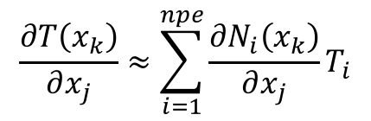
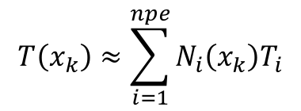
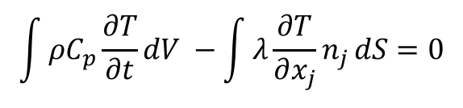
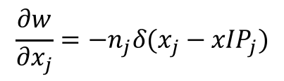
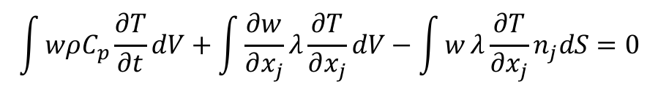
The Hybrid Control-Volume Finite Element Method (CVFEM)
A combination between the edge-based vertex-centered and FEM is the method known as Control Volume Finite Element ()
A dual mesh is constructed to obtain flux and volume quadrature locations
As with FEM, a basis is defined:
$$T\left(x_{k}\right)≈\sum_{i=1}^{npe}{N_{i}\left(x_{k}\right)T_{i}}$$
$$\frac{∂T\left(x_{k}\right)}{∂x_{j}}≈\sum_{i=1}^{npe}{{\frac{∂N_{i}\left(x_{k}\right)}{∂x_{j}}T}_{i}}$$
Integration-by-parts over test function w:
However, define a test function, w, as a piece-wise constant function (Heavyside) to be 1 inside the dual volume and 0 outside. Gradient is a Dirac-delta function:
Leading to:
$$\int{wρC_{p}\frac{∂T}{∂t}dV+\int{\frac{∂w}{∂x_{j}}λ\frac{∂T}{∂x_{j}}}dV−\int{w}λ\frac{∂T}{∂x_{j}}n_{j}dS=0}$$
$$\frac{∂w}{∂x_{j}}=−n_{j}δ(x_{j}−{xIP}_{j})$$
$$\int{ρC_{p}\frac{∂T}{∂t}dV −\int{λ\frac{∂T}{∂x_{j}}n_{j}}dS=0}$$
Dual-volume definition

Slide 10

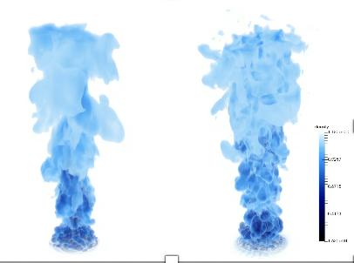
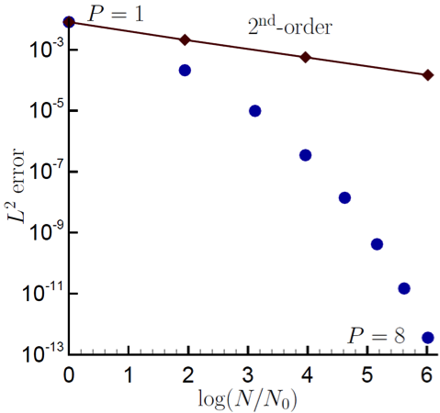
Control-Volume Finite Element Method Attributes
The CVFEM method, therefore, is a finite volume scheme that is locally conservative, i.e., momentum leaving one dual volume face enters the adjacent dual volume
However, the gradient operator, like its FEM counterpart is absent of any error due to non-orthogonality
Since the test-function, w, is different from the underlying basis representation, this method can be considered a Petrov-Galerkin method
The method can also be promoted in polynomial space
P=1 (left) and P=4 (right)
Helium plume (VR-density)
Spectral convergence
Dual-volume for promoted quad4

Slide 11
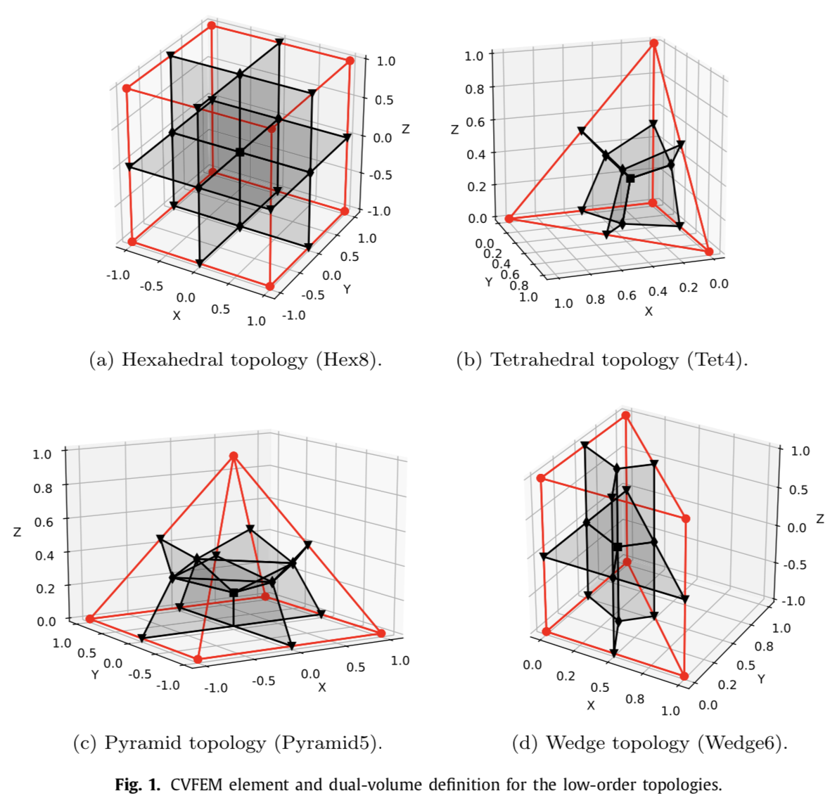
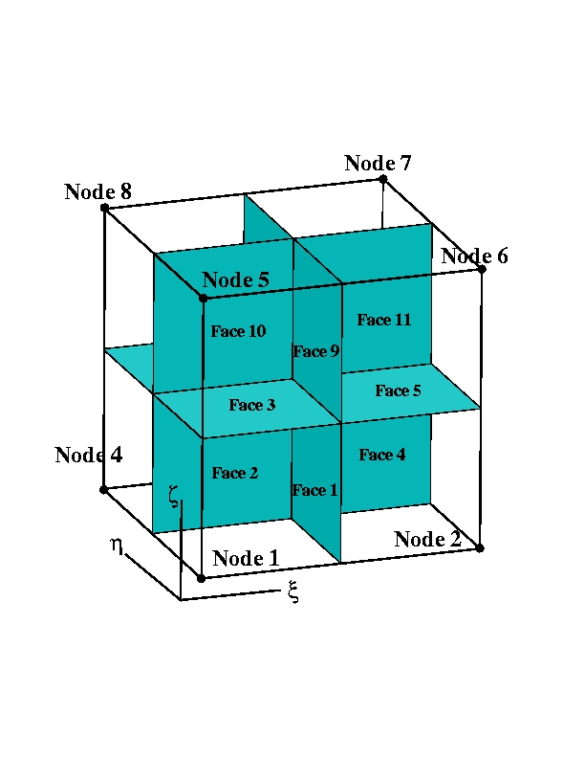
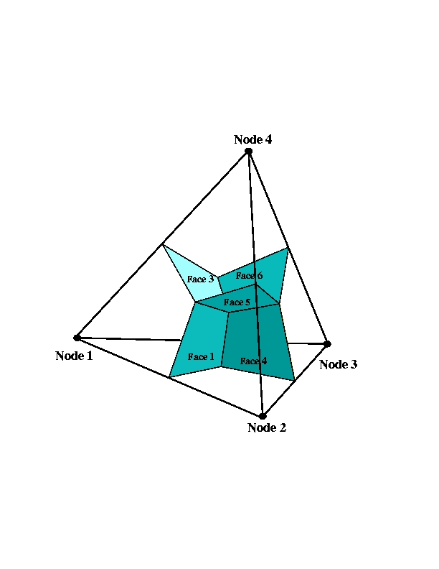
Dual Volume Definitions for Hybrid Meshes
Domino, et. al, “An assessment of atypical mesh topologies for low-Mach large-eddy simulation” 2019

Slide 12

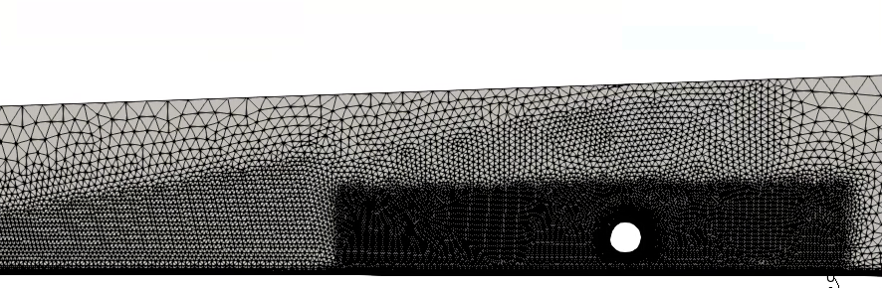
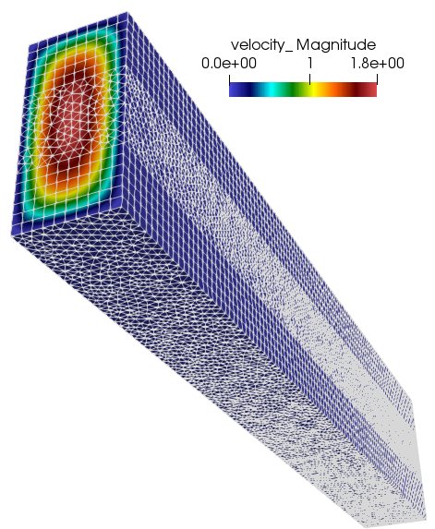
Recent Generalized Unstructured Findings
Domino, et. al, “An assessment of atypical mesh topologies for low-Mach large-eddy simulation” 2019

Slide 13
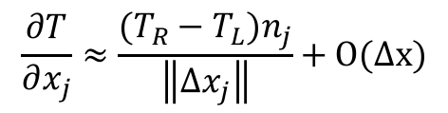
Equal Order Interpolation Edge-Based Vertex-Centered (EBVC) Finite Volume
All primitives are collocated at the vertices of the elements with equal-order interpolation
A dual mesh is constructed to obtain flux and volume quadrature locations
Classic two-state, “L” and “R” approach provides spatially second-order accuracy
Surface quadrature point (area summed to edge)
Volume quadrature point (sub-vol summed to node)
Same grad-op as CC:
Iterate nodes for volume contributions
Iterate edges for surface flux contribution
$$\frac{∂T}{∂x_{j}}≈\frac{(T_{R}−T_{L})n_{j}}{\left\|{Δx}_{j}\right\|}+O(∆x)$$
T_{L}
n_{j}
T_{R}
Dual-volume definition
Edge-based stencil

Slide 14
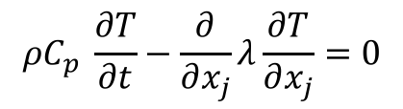
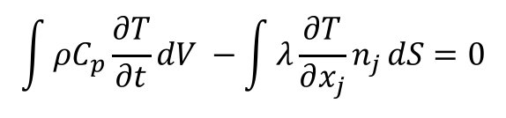
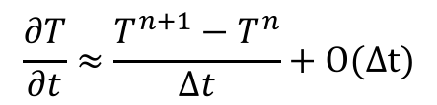
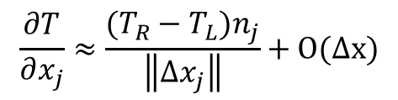
Equal-Order Interpolation Cell-Centered (CC) Finite Volume
All primitives are collocated at the cell-center of the element with equal-order interpolation
Classic two-state, “L” and “R” approach provides spatially second-order accuracy
Consider a simple heat conduction model PDE,
Integrate over a control volume and use Gauss-Divergence,
Iterate element cell-centers for volume contributions (time/source)
Iterate element faces for surface flux contribution
Surface
quadrature point
$$ρC_{p} \frac{∂T}{∂t}−\frac{∂}{∂x_{j}}λ\frac{∂T}{∂x_{j}}=0$$
T_{L}
T_{R}
$$\int{ρC_{p}\frac{∂T}{∂t}dV −\int{λ\frac{∂T}{∂x_{j}}n_{j}}dS=0}$$
n_{j}
$$\frac{∂T}{∂x_{j}}≈\frac{(T_{R}−T_{L})n_{j}}{\left\|{Δx}_{j}\right\|}+O(∆x)$$
with:
$$\frac{∂T}{∂t}≈\frac{T^{n+1}−T^{n}}{Δt}+O(∆t)$$

Slide 15
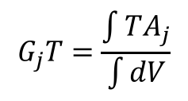
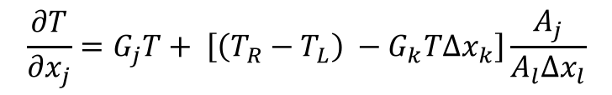
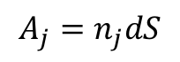
Typical Failings for Two-State Discretization Methods
With two points, only a linear basis can be used.
Therefore, unstructured CC and EBVC are limited to second-order spatial accuracy
Non-orthogonality is problematic for gradient-operator
Above, G_{j}T is a projected nodal gradient at the cell-center, or vertex center:
Non-orthogonality is simply defined as the mis-alignment of the distance vector between the two ”L” and “R” states and the surface normal
Both edge- and cell centered-based schemes show degraded accuracy on typical production meshes
Several non-orthogonality approaches are available, for the best source, see Jasak
Jasak, “Error analysis and error estimation for the finite volume method with applications to fluid flow”, Imperial College Dissertation, 1996
$$\frac{∂T}{∂x_{j}}=G_{j}T+ \left[\left(T_{R}−T_{L}\right) −G_{k}T∆x_{k}\right]\frac{A_{j}}{A_{l}∆x_{l}}$$
Δx_{j}
n_{j}
With area vector defined by:
$$A_{j}=n_{j}dS$$
$$G_{j}T=\frac{\int{TA_{j}}}{\int{dV}}$$

Slide 16
Classic Staggered Finite Volume
Stencil for CC-quantities
Stencil for x-velocity
Stencil for y-velocity
Velocity degree-of-freedom is staggered relative to pressure and other primitives, e.g., enthalpy, mixture fraction, etc.
P_{N}
P_{S}

Slide 17
Attributes of a Staggered Scheme
By design, non-orthogonality is absent, however, complex geometry will be stair-stepped
From a fluids perspective, the operators are ideal, i.e., pressure gradient for momentum is compact, e.g., (P_{E} – P_{W})Δx⁻¹
As will be seen in future lecture topics, the skew-adjoint nature of the Divergence operator, D, and Gradient operator, G, allows for a Laplace operator, L = DG
Can be extended to higher-order
Frequently, meshing complex geometries can be extremely difficult (consider our V27 example)

Slide 18
Common low-Mach Discretization Approaches: Conclusions
Two-state methods, e.g., cell-centered and EBVC are attractive due to simplicity, however, suffer from non-orthogonality issues in the diffusion operator
FEM provides a machinery to provide accurate discretizations on non-ideal meshes, however, the same diffusion operator suffers on high-aspect ratio meshes
CVFEM is a hybrid method that contains the likeable attributes of both FV and FEM (same high-aspect ratio diffusion operator finding)
Staggered arrangement is well suited for a class of fluid mechanics applications where low-order or simple geometries are found

